Slide 1

CSE- 102
Introduction to CS and
Programming Methodology Lab
Lab : 09 Switch case, Loop
Fahad Ahmed
Lecturer, Dept. of CSE
E-mail: fahadahmed@uap-bd.edu

Slide 2
Lab-09 class performance
Write a C program to print number of days of a month
Input
Enter month number (1-12): 1
Output
31 days.
Input
Enter month number (1-12): 2
Output
28 or 29 days.

Slide 3
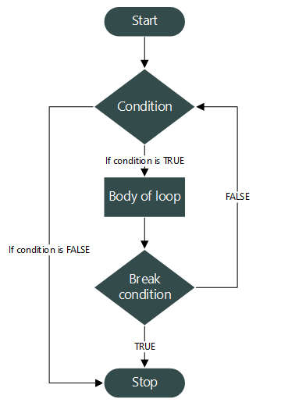
break statement in C

Slide 4
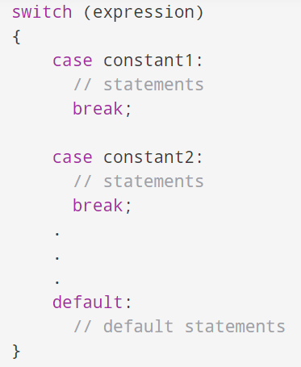
C switch Statement
Syntax of switch...case

Slide 5
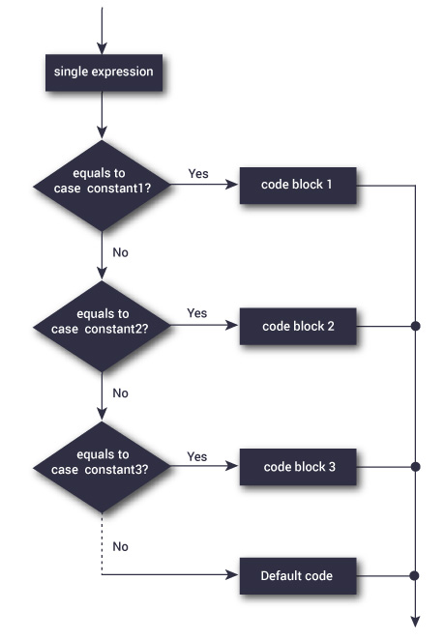
C switch Statement

Slide 6
C switch Statement
C program to find maximum between two numbers using switch case

Slide 7
C switch Statement
#include <stdio.h>
int main()
{
int num1, num2;
printf("Enter two numbers to find maximum: ");
scanf("%d%d", &num1, &num2);
/* Expression (num1 > num2) will return either 0 or 1 */
switch(num1 > num2)
{
/* If condition (num1>num2) is false */
case 0:
printf("%d is maximum", num2);
break;
/* If condition (num1>num2) is true */
case 1:
printf("%d is maximum", num1);
break;
}
return 0;
}

Slide 8
C switch Statement
C program to create calculator using switch case
+
2 9

Slide 9
C switch Statement
#include <stdio.h>
int main() {
char operator;
double n1, n2;
printf("Enter an operator (+, -, *, /): ");
scanf("%c", &operator);
printf("Enter two operands: ");
scanf("%lf %lf",&n1, &n2);
switch(operator)
{
case '+':
printf("%.1lf + %.1lf = %.1lf",n1, n2, n1+n2);
break;
case '-':
printf("%.1lf - %.1lf = %.1lf",n1, n2, n1-n2);
break;
case '*':
printf("%.1lf * %.1lf = %.1lf",n1, n2, n1*n2);
break;
case '/':
printf("%.1lf / %.1lf = %.1lf",n1, n2, n1/n2);
break;
// operator doesn't match any case constant +, -, *, /
default:
printf("Error! operator is not correct");
}
return 0;
}

Slide 10
C switch Statement
Program to check positive negative or zero using nested switch case

Slide 11
C switch Statement
#include <stdio.h>
int main()
{
int num;
printf("Enter any number: ");
scanf("%d", &num);
switch (num > 0)
{
// Num is positive
case 1:
printf("%d is positive.", num);
break;
// Num is either negative or zero
case 0:
switch (num < 0)
{
case 1:
printf("%d is negative.", num);
break;
case 0:
printf("%d is zero.", num);
break;
}
break;
}
return 0;
}

Slide 12
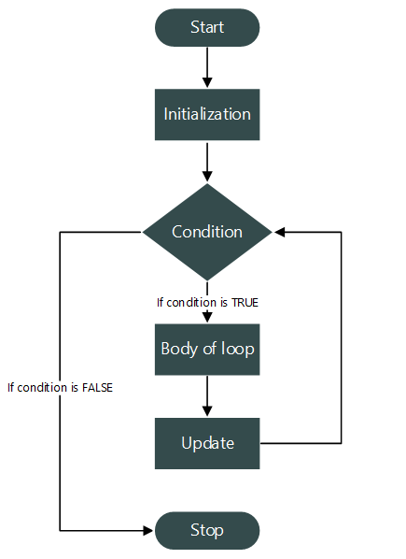
C for Loop
Syntax of for loop
for(variable-initialization ; condition ; variable-update)
{
// Body of for loop
}

Slide 13
C for Loop
C program to print natural numbers from 1 to n.

Slide 14
C for Loop
#include <stdio.h>
int main()
{
/* Declare loop counter variable */
int count;
/* Run a loop from 1 to 10 */
for(count=1; count<=10; count++)
{
/* Print current value of count */
printf("%d ", count);
}
return 0;
}

Slide 15
C for Loop
Program to calculate the sum of first n natural numbers

Slide 16
C for Loop
#include <stdio.h>
int main()
{
int num, count, sum = 0;
printf("Enter a positive integer: ");
scanf("%d", &num);
// for loop terminates when num is less than count
for(count = 1; count <= num; ++count)
{
sum += count;
}
printf("Sum = %d", sum);
return 0;
}

Slide 17
C for Loop
Program to print alphabets from a-z

Slide 18
C for Loop
#include <stdio.h>
int main()
{
int i;
printf("Alphabets from a - z are: \n");
/* ASCII value of a=97 */
for(i=97; i<=122; i++)
{
printf("%c\n", i);
}
return 0;
}

Slide 19
C for Loop
Another way
#include <stdio.h>
int main()
{
char ch;
printf("Alphabets from a - z are: \n");
for(ch='a'; ch<='z'; ch++)
{
printf("%c\n", ch);
}
return 0;
}

Slide 20
C for Loop
Perfect number, a positive integer that is equal to the sum of its proper divisors. The smallest perfect number is 6, which is the sum of 1, 2, and 3. Other perfect numbers are 28, 496, and 8,128
Write a C program for it

Slide 21
C for Loop
# include <stdio.h>
int main()
{
int i, Number, Sum = 0 ;
printf("\n Please Enter any number \n") ;
scanf("%d", &Number) ;
for(i = 1 ; i < Number ; i++)
{
if(Number % i == 0)
Sum = Sum + i ;
}
if (Sum == Number)
printf("\n %d is a Perfect Number", Number) ;
else
printf("\n%d is not the Perfect Number", Number) ;
return 0 ;
}

Slide 22
Home work
Write a program in C to check whether a number is prime or not.
C Program to Find Factorial of a Number

Slide 23

Thanks to All

